Slide 1
Aggregation of Environmental Indicators for Vulnerability & Risk Assessment

Slide 2
Logistics
We are going to start on Problem Set 2 in lab Monday, I will try to post it on Cicada before the end of the week.
It will employ Interpolation, the Aggregation Techniques we will begin to learn today, and a *little* bit of GIS.
Remember, Reading Assignment 4 is due at midnight on Monday.

Slide 3
Today’s Goals
What is data aggregation? Why use it?
What is an example of data aggregation?
What else should I know?

Slide 4
Index Creation & Data Aggregation
Take multiple datasets in different units (e.g., precipitation; temperature) and aggregate them into one single indicator.
E.g., Temperature + Precipitation = Vulnerability
What’s wrong with the above example?

Slide 5
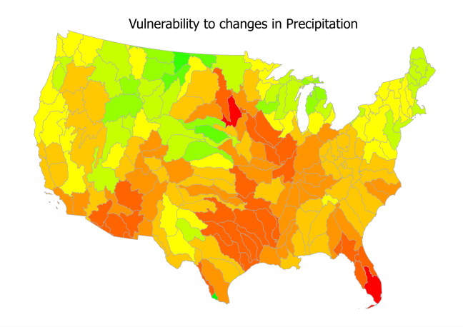
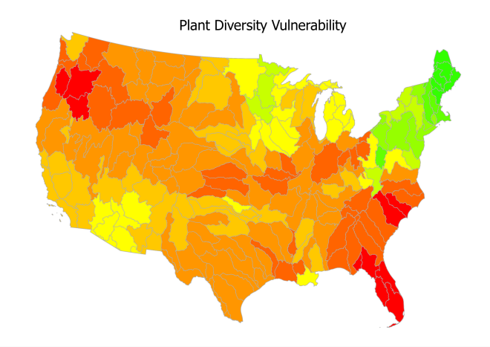
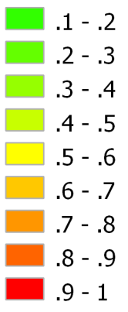
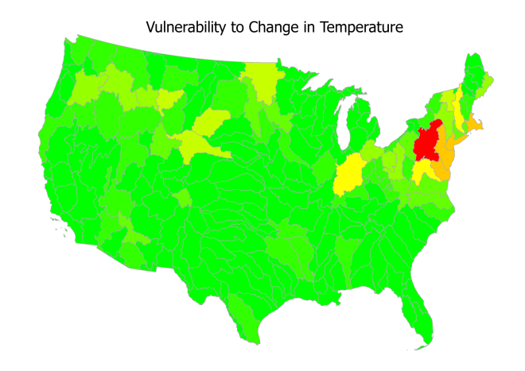
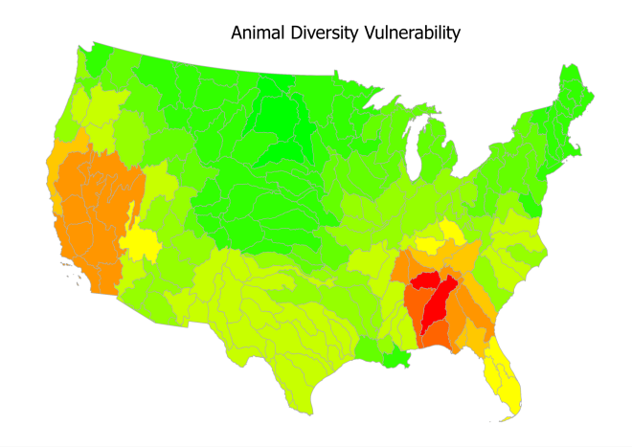
Which areas do we need to fund?

Slide 6
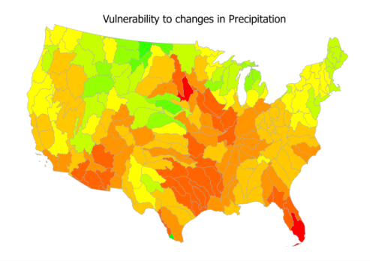
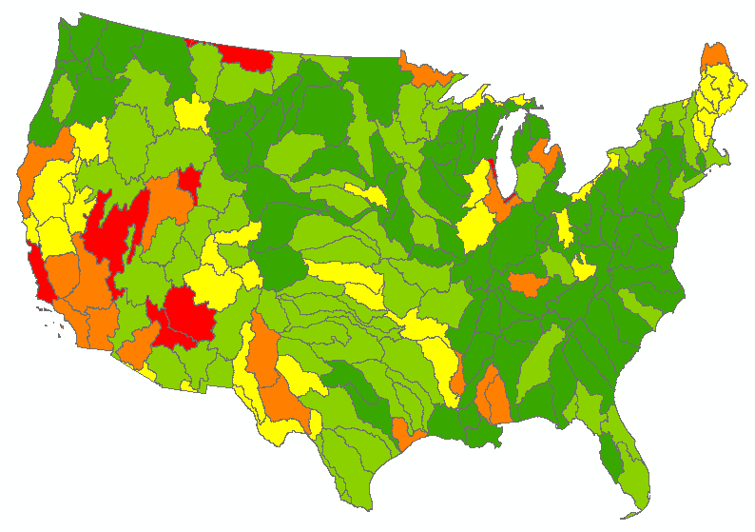


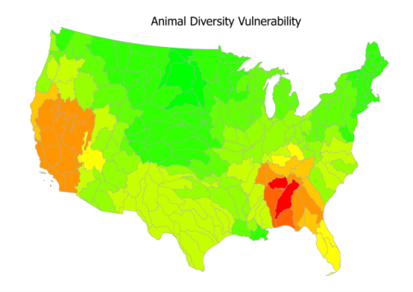
Which areas do we need to fund?

Slide 7
Today’s Goals
What is data aggregation? Why use it?
What is an example of data aggregation?
What else should I know?

Slide 8
Steps!
(1) Data Selection
(2) Data Creation / Identification / Integration
(3) Multivariate Analysis
(4) Standardization
(5) Weighting
(6) Aggregation
(7) Sensitivity / Uncertainty
(8) Analysis / Visualization

Slide 9
Getting Started
Data Selection: Theoretically driven.
What is your research question?
What data might be relevant to get at it?
Data Creation / Identification / Integration
Is the data you need already available?
Do you have it in a Geodatabase?
Multivariate Analysis
Is your data measuring unique aspects of the system, or is it all measuring the same thing?

Slide 10
[EXCEL EXAMPLE OF MULTIVARIATE ANALYSIS]

Slide 11
Steps!
(1) Data Selection
(2) Data Creation / Identification / Integration
(3) Multivariate Analysis
(4) Standardization
(5) Weighting
(6) Aggregation
(7) Sensitivity / Uncertainty
(8) Analysis / Visualization

Slide 12
Standardization
Attributes in different units need to be standardized so they are comparable.
E.g., adding the number of people living in an area to the annual temperature make no sense, conceptually or mathematically.

Slide 13
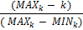
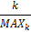
Techniques for Standardization
Data Standardization Approach | Short Summary | Sources
Quantile | Data are grouped into quantiles, then scaled from 0-1 based on which quantile they fall into. | (Hurd, Leary et al. 1999; Alessa, Kliskey et al. 2008; Perch-Nielsen 2010)
Human Development Index |  | (Sharma and Patwardhan 2008)
Division by Max (Theoretical Max can be substituted) |  | (Cutter, Mitchell et al. 2000; Wu, Yarnal et al. 2002; SDI 2010)
Z-Scores | The number of standard deviations the indicator value is from the mean. | (Wood, Burton et al. 2010)
As a proportion of an external indicator | Dataset normalized by an external dataset (e.g., monetary values in terms of 1990 dollars) | (Auerbach 1981; Moss, Brenkert et al. 2002; Cutter, Boruff et al. 2003; Brooks, Neil Adger et al. 2005)
Thresholding | Either survey design or post-hoc thresholds are determined to separate datasets into comparable sets (e.g., expert decision on what threshold for heat indicates "high vulnerability") | (Shoaf, Seligson et al. 2006; Aceves-Quesada, Diaz-Salgado et al. 2007; López-Marrero and Yarnal 2010; NOAA 2010)

Slide 14
When to use each Technique
Quantile
Indicator has limited precision or accuracy
Groupings are more interesting than actual values
EXAMPLE:
Data on economic welfare for countries around the world.
Biggest Disadvantage:
You do not retain information on the absolute differences between different values.

Slide 15
When to use each Technique
Human Development Index
Differences between scores within the indicator are very important
Effectively “stretches” the values from 0 to 1.
EXAMPLE:
Stream Flow Variability
Biggest Disadvantage:
Stretching can suggest larger differences than actually exist.

Slide 16
When to use each Technique
Division by Max
Absolute values are important
Data is very precise
EXAMPLE:
Precipitation if the goal is to estimate absolute risk of flooding.
Biggest Disadvantage:
Very data-reliant!

Slide 17
When to use each Technique
Z-Scores
Interested in how unusual a unit is compared to the mean
EXAMPLE:
Precipitation if the goal is to estimate relative risk of flooding events.
Biggest Disadvantage:
Only helpful for relative studies (cannot be used to determine absolute risk)

Slide 18
When to use each Technique
Proportion of an external indicator
Mostly done to compare economic outputs
EXAMPLE:
The GDP of Great Britain in 1990 as a proportion of the US’s GDP
Biggest Disadvantage:
Only makes sense if you have a relevant external indicator.

Slide 19
When to use each Technique
Thresholding
Can help to group areas into different levels of vulnerability when you have a great deal of knowledge about the indicator
EXAMPLE:
CO2 emissions – Levels below ~200PPM may not be concerning, levels from 200-400PPM are of some concern, 400PPM + are very concerning.
Biggest Disadvantage:
You have to know your indicator VERY well. Very labor intensive.

Slide 20
When to use each Technique
Rank-Order
Very helpful if you cannot threshold, and have limited information about the accuracy of your data.
For Each Attribute, you:
Determine the rank of each unit of analysis (in our case, Hydrologic Unit Codes [HUCs]). Make sure to rank in the right order – more vulnerable areas need to have a lower rank, while less vulnerable areas should have smaller values / higher ranks (closer to 1).
Divide each value by the maximum rank.
Flood Risk Example (more rain = more risk)
HUC ID | Precip (mm/week) | Rank-Order | Rank / Max Rank
100 | 1.1 | 1 | (1/10) = 0.1
101 | 2.3 | 5 | (5/10) = 0.5
102 | 3.1 | 7 | 0.7
103 | 3.3 | 8 | 0.8
201 | 2.5 | 6 | 0.6
202 | 1.7 | 4 | 0.4
203 | 1.6 | 3 | 0.3
965 | 1.5 | 2 | 0.2
1810 | 13 | 10 | 1.0
1805 | 5 | 9 | 0.9
Vörösmarty, C., P. McIntyre, et al. (2010). "Global threats to human water security and river biodiversity." Nature 467(7315): 555-561.

Slide 21
[EXCEL EXAMPLE OF STANDARDIZATION]

Slide 22
Steps!
(1) Data Selection
(2) Data Creation / Identification / Integration
(3) Multivariate Analysis
(4) Standardization
(5) Weighting
(6) Aggregation
(7) Sensitivity / Uncertainty
(8) Analysis / Visualization

Slide 23
Many methods for weighting…
You already learned:
Relative to minimum
What is the least important attribute? How many times more important are other attributes than it?
Swing Weighting
How important is a swing from the worst outcome to the best for a given indicator?

Slide 24
Many methods for weighting…
Most commonly applied weighting approach in risk assessment is “Equal Weights”, in which every attribute receives the same weight (generally 1 / the number of attributes).
This assumes that all indicators are equally important!
AHP will be our next tool.

Slide 25
Considerations when you weight
Multicollinearity! If two indicators have the same data in them, giving them a lot of weight can lead to “double counting”.
Sensitivity! Even if you choose not to weight (aka Equal Weighting), your results still might be sensitive to that decision.

Slide 26
Steps!
(1) Data Selection
(2) Data Creation / Identification / Integration
(3) Multivariate Analysis
(4) Standardization
(5) Weighting
(6) Aggregation
(7) Sensitivity / Uncertainty
(8) Analysis / Visualization

Slide 27
Aggregation Strategies
Weighted Linear Combination (WLC)
Data Envelopment Analysis (DEA)
Pareto Rank Order (PAR)
Ordered Weighted Average (OWA)
Weighted Ordered Weighted Average (WOWA)

Slide 28

Weighted Linear Combination
You’ve already used this one as a part of SMART!
Establish weights based on some method (e.g., swing weighting).
Multiply each weight by the attribute value.

Slide 29
Examples: Rank Order Standardization
HUC ID | Precip (mm/week) | Rank-Order | Rank / Max Rank
100 | 1.1 | 1 | (1/10) = 0.1
101 | 2.3 | 5 | (5/10) = 0.5
102 | 3.1 | 7 | 0.7
103 | 3.3 | 8 | 0.8
201 | 2.5 | 6 | 0.6
202 | 1.7 | 4 | 0.4
203 | 1.6 | 3 | 0.3
965 | 1.5 | 2 | 0.2
1810 | 13 | 10 | 1.0
1805 | 5 | 9 | 0.9
HUC ID | People in Flood Plain | Rank-Order | Rank / Max Rank
100 | 110 | 4 | (4/10) = 0.4
101 | 200 | 7 | (7/10) = 0.7
102 | 150 | 5 | 0.5
103 | 175 | 6 | 0.6
201 | 300 | 8 | 0.8
202 | 350 | 9 | 0.9
203 | 12500 | 10 | 1.0
965 | 100 | 3 | 0.3
1810 | 50 | 2 | 0.2
1805 | 10 | 1 | 0.1

Slide 30
Examples: Weighted Linear Combination
Weights: Precip = 0.4 People in Flood Plain = 0.6
HUC ID | Standardized Precipitation | Standardized People in Flood Plain | Weighted Linear Combination
100 | 0.1 | 0.4 | =(0.4 * 0.1) + (0.6 * 0.4) = 0.28
101 | 0.5 | 0.7 | =(0.4 * 0.5) + (0.6 * 0.7) = 0.62
102 | 0.7 | 0.5 | ???
103 | 0.8 | 0.6
201 | 0.6 | 0.8
202 | 0.4 | 0.9
203 | 0.3 | 1.0
965 | 0.2 | 0.3
1810 | 1.0 | 0.2
1805 | 0.9 | 0.1

Slide 31
Examples: Weighted Linear Combination
Weights: Precip = 0.4 People in Flood Plain = 0.6
HUC ID | Standardized Precipitation | Standardized People in Flood Plain | Weighted Linear Combination
100 | 0.1 | 0.4 | =(0.4 * 0.1) + (0.6 * 0.4) = 0.28
101 | 0.5 | 0.7 | =(0.4 * 0.5) + (0.6 * 0.7) = 0.62
102 | 0.7 | 0.5 | 0.58
103 | 0.8 | 0.6 | 0.68
201 | 0.6 | 0.8 | 0.72
202 | 0.4 | 0.9 | 0.7
203 | 0.3 | 1.0 | 0.72
965 | 0.2 | 0.3 | 0.26
1810 | 1.0 | 0.2 | 0.58
1805 | 0.9 | 0.1 | 0.42

Slide 32
Examples: WLC
Weights: Precip = 0.4 People in Flood Plain = 0.6
HUC ID | Standardized Precipitation | Standardized People in Flood Plain | Weighted Linear Combination
100 | 0.1 | 0.4 | =(0.4 * 0.1) + (0.6 * 0.4) = 0.28
101 | 0.5 | 0.7 | =(0.4 * 0.5) + (0.6 * 0.7) = 0.62
102 | 0.7 | 0.5 | 0.58
103 | 0.8 | 0.6 | 0.68
201 | 0.6 | 0.8 | 0.72
202 | 0.4 | 0.9 | 0.7
203 | 0.3 | 1.0 | 0.72
965 | 0.2 | 0.3 | 0.26
1810 | 1.0 | 0.2 | 0.58
1805 | 0.9 | 0.1 | 0.42
If we used these values to determine which HUCs to fund, we would potentially ignore an area that is highly likely to flood due to precipitation, just because it has less people that are at risk!
In other words: The low number of people has averaged out the high precipitation chance.
The OWA offers a solution to this.

Slide 33
What is an Ordered Weighted Average (OWA)?
OWA is a method to aggregate data which weights based on rank order. Constituent Indicator values for each HUC are ranked largest to smallest.
Example
Weights are assigned to a rank in OWA. This example will assign:
Rank 1: .6 Rank 2: .4
Given the data to the left…. HUC-ID 1 would have a final value of:
(10 * .4) + (30 * .6) = 22
HUC-ID 2 would have a final value of:
(20 * .6) + (5 * .4) = 14
HUC-ID | Indicator 1 | Indicator 2
1 | 10 | 30
2 | 20 | 5
In this example weighting scheme, the larger values in each row are given more weight, but the rank weights can be distributed to give a range of weighting schemes.
Yager, R. (1988). On ordered weighted averaging aggregation operators in multicriteria decisionmaking. IEEE transactions on Systems, Man and Cybernetics 18, 183-190.

Slide 34
Examples: OWA
Rank Weights: Rank 1 = 0.8 Rank 2 = 0.2
HUC ID | Standardized Precipitation | Standardized People in Flood Plain | Ordered Weighted Average
100 | 0.1 | 0.4 | = (0.2 * 0.1) + (0.8 * 0.4) = 0.34
101 | 0.5 | 0.7
102 | 0.7 | 0.5
103 | 0.8 | 0.6
201 | 0.6 | 0.8
202 | 0.4 | 0.9
203 | 0.3 | 1.0
965 | 0.2 | 0.3
1810 | 1.0 | 0.2
1805 | 0.9 | 0.1
First, the two attributes are ranked: in this case, the number of people in the flood plain is larger than the standardized precipitation (0.4 > 0.1), so it received rank 1. Precipitation received rank 2. We then multiple by the appropriate rank weight to get our final valuation.

Slide 35
Examples: OWA
Rank Weights: Rank 1 = 0.8 Rank 2 = 0.2
HUC ID | Standardized Precipitation | Standardized People in Flood Plain | Ordered Weighted Average
100 | 0.1 | 0.4 | = (0.2 * 0.1) + (0.8 * 0.4) = 0.34
101 | 0.5 | 0.7 | = (0.2 * 0.5) + (0.8 * 0.7) = 0.66
102 | 0.7 | 0.5 | ???
103 | 0.8 | 0.6
201 | 0.6 | 0.8
202 | 0.4 | 0.9
203 | 0.3 | 1.0
965 | 0.2 | 0.3
1810 | 1.0 | 0.2
1805 | 0.9 | 0.1

Slide 36
Examples: OWA
Rank Weights: Rank 1 = 0.8 Rank 2 = 0.2
HUC ID | Standardized Precipitation | Standardized People in Flood Plain | Ordered Weighted Average
100 | 0.1 | 0.4 | = (0.2 * 0.1) + (0.8 * 0.4) = 0.34
101 | 0.5 | 0.7 | = (0.2 * 0.5) + (0.8 * 0.7) = 0.66
102 | 0.7 | 0.5 | 0.66
103 | 0.8 | 0.6 | 0.76
201 | 0.6 | 0.8 | 0.76
202 | 0.4 | 0.9 | 0.8
203 | 0.3 | 1.0 | 0.86
965 | 0.2 | 0.3 | 0.28
1810 | 1.0 | 0.2 | 0.84
1805 | 0.9 | 0.1 | 0.74

Slide 37
Examples: OWA
Rank Weights: Rank 1 = 0.8 Rank 2 = 0.2
HUC ID | Standardized Precipitation | Standardized People in Flood Plain | Ordered Weighted Average
100 | 0.1 | 0.4 | = (0.2 * 0.1) + (0.8 * 0.4) = 0.34
101 | 0.5 | 0.7 | = (0.2 * 0.5) + (0.8 * 0.7) = 0.66
102 | 0.7 | 0.5 | 0.66
103 | 0.8 | 0.6 | 0.76
201 | 0.6 | 0.8 | 0.76
202 | 0.4 | 0.9 | 0.8
203 | 0.3 | 1.0 | 0.86
965 | 0.2 | 0.3 | 0.28
1810 | 1.0 | 0.2 | 0.84
1805 | 0.9 | 0.1 | 0.74
Using this approach, the small number in the number of people in the flood plain is not allowed to average out as much of the high value in precipitation as it used too. Thus, this HUC that is at a high chance for flooding is ranked high using the WOWA.
The degree to which averaging out is allowed to occur is called “ORness” in the OWA.

Slide 38
Optimistic / Pessimistic Outlooks and assigning the OWA Rank Weights
The degree of “ORness” chosen allows for the selection of Rank Weights based on an optimistic or pessimistic outlook.
For an optimistic outlook full trade-off is allowed - low values can compensate for (or “average out”) high values.
Pessimistic
Low Tradeoff
Optimistic
High Tradeoff
Orness = .95
Rank | Weight
1 | .830
2 | .140
3 | .020
4 | .010
5 | .001
Orness = .75
Rank | Weight
1 | .460
2 | .260
3 | .140
4 | .080
5 | .050
Orness = .5
Rank | Weight
1 | .20
2 | .20
3 | .20
4 | .20
5 | .20
Malczewski, J., Chapman, T., Flegel, C., Walters, D., Shrubsole, D., and Healy, M. (2003). GIS-multicriteria evaluation with ordered weighted averaging (OWA): case study of developing watershed management strategies. Environment and Planning A 35, 1769-1784.
Jiang, H. & Eastman, J. (2000). Application of Fuzzy Measures in Multi-Criteria Evaluation in GIS. Int. J. Geographical Information Science. 14(2): 173-184.

Slide 39
Optimistic / Pessimistic Outlooks and assigning the OWA Rank Weights
The degree of “ORness” chosen allows for the selection of Rank Weights based on an optimistic or pessimistic outlook.
For a pessimistic decision strategy a low degree of tradeoff is allowed: low values are not able to compensate for high values (“average out”).
Pessimistic
Low Tradeoff
Optimistic
High Tradeoff
Orness = .95
Rank | Weight
1 | .830
2 | .140
3 | .020
4 | .010
5 | .001
Orness = .75
Rank | Weight
1 | .460
2 | .260
3 | .140
4 | .080
5 | .050
Orness = .5
Rank | Weight
1 | .20
2 | .20
3 | .20
4 | .20
5 | .20

Slide 40
Weighted OWA
Weights: Precip = 0.4 People in Flood Plain = 0.6
Rank Weights: Rank 1 = 0.8 Rank 2 = 0.2
HUC ID | Standardized Precipitation | Standardized People in Flood Plain | Weighted Precip | Weighted People | Weighted Linear Combination
100 | 0.1 | 0.4 | =0.1 * 0.4 | =0.4 * 0.6
101 | 0.5 | 0.7
102 | 0.7 | 0.5
103 | 0.8 | 0.6
201 | 0.6 | 0.8
202 | 0.4 | 0.9
203 | 0.3 | 1.0
965 | 0.2 | 0.3
1810 | 1.0 | 0.2
1805 | 0.9 | 0.1

Slide 41
Weighted OWA
Weights: Precip = 0.4 People in Flood Plain = 0.6
Rank Weights: Rank 1 = 0.8 Rank 2 = 0.2
HUC ID | Standardized Precipitation | Standardized People in Flood Plain | Weighted Precip | Weighted People | Weighted Linear Combination
100 | 0.1 | 0.4 | =0.1 * 0.4 | =0.4 * 0.6
101 | 0.5 | 0.7 | ?? | ??
102 | 0.7 | 0.5
103 | 0.8 | 0.6
201 | 0.6 | 0.8
202 | 0.4 | 0.9
203 | 0.3 | 1.0
965 | 0.2 | 0.3
1810 | 1.0 | 0.2
1805 | 0.9 | 0.1

Slide 42
Weighted OWA
Weights: Precip = 0.4 People in Flood Plain = 0.6
Rank Weights: Rank 1 = 0.8 Rank 2 = 0.2
HUC ID | Standardized Precipitation | Standardized People in Flood Plain | Weighted Precip | Weighted People | Weighted Ordered Weighted Average
100 | 0.1 | 0.4 | .04 | .24 | =(.24 * 0.8) + (.04 * 0.2)
101 | 0.5 | 0.7 | .2 | .42 | ??
102 | 0.7 | 0.5 | .28 | .3
103 | 0.8 | 0.6 | .32 | .36
201 | 0.6 | 0.8 | .24 | .48
202 | 0.4 | 0.9 | .16 | .54
203 | 0.3 | 1.0 | .12 | .6
965 | 0.2 | 0.3 | .08 | .18
1810 | 1.0 | 0.2 | .4 | .12
1805 | 0.9 | 0.1 | .36 | .06

Slide 43
Weighted OWA
Weights: Precip = 0.4 People in Flood Plain = 0.6
Rank Weights: Rank 1 = 0.8 Rank 2 = 0.2
HUC ID | Standardized Precipitation | Standardized People in Flood Plain | Weighted Precip | Weighted People | Weighted Ordered Weighted Average
100 | 0.1 | 0.4 | .04 | .24 | .2
101 | 0.5 | 0.7 | .2 | .42 | .37
102 | 0.7 | 0.5 | .28 | .3 | .29
103 | 0.8 | 0.6 | .32 | .36 | .35
201 | 0.6 | 0.8 | .24 | .48 | .43
202 | 0.4 | 0.9 | .16 | .54 | .46
203 | 0.3 | 1.0 | .12 | .6 | .50
965 | 0.2 | 0.3 | .08 | .18 | .16
1810 | 1.0 | 0.2 | .4 | .12 | .34
1805 | 0.9 | 0.1 | .36 | .06 | .3

Slide 44
Weighted OWA
Weights: Precip = 0.4 People in Flood Plain = 0.6
Rank Weights: Rank 1 = 0.8 Rank 2 = 0.2
HUC ID | Standardized Precipitation | Standardized People in Flood Plain | Weighted Precip | Weighted People | Weighted Ordered Weighted Average
100 | 0.1 | 0.4 | .04 | .24 | =(.24 * 0.8) + (.04 * 0.2)
101 | 0.5 | 0.7 | .2 | .42
102 | 0.7 | 0.5 | .28 | .3
103 | 0.8 | 0.6 | .32 | .36
201 | 0.6 | 0.8 | .24 | .48
202 | 0.4 | 0.9 | .16 | .54
203 | 0.3 | 1.0 | .12 | .6
965 | 0.2 | 0.3 | .08 | .18
1810 | 1.0 | 0.2 | .4 | .12
1805 | 0.9 | 0.1 | .36 | .06
In WOWA it is important to apply the weights FIRST, then rank for the rank weights SECOND. Look at this example: if you applied rank weights before weighting, you would get a different ranking of attributes than you do after you apply the weights.

Slide 45
Comparing All Results
Weights: Precip = 0.4 People in Flood Plain = 0.6
Rank Weights: Rank 1 = 0.8 Rank 2 = 0.2
HUC ID | Standardized Precipitation | Standardized People in Flood Plain | WLC | OWA | WOWA
100 | 0.1 | 0.4 | 0.28 | 0.34 | .2
101 | 0.5 | 0.7 | 0.62 | 0.66 | .37
102 | 0.7 | 0.5 | 0.58 | 0.66 | .29
103 | 0.8 | 0.6 | 0.68 | 0.76 | .35
201 | 0.6 | 0.8 | 0.72 | 0.76 | .43
202 | 0.4 | 0.9 | 0.7 | 0.8 | .46
203 | 0.3 | 1.0 | 0.72 | 0.86 | .50
965 | 0.2 | 0.3 | 0.26 | 0.28 | .16
1810 | 1.0 | 0.2 | 0.58 | 0.84 | .34
1805 | 0.9 | 0.1 | 0.42 | 0.74 | .3

Slide 46
[EXCEL EXAMPLE]

Slide 47
Steps!
(1) Data Selection
(2) Data Creation / Identification / Integration
(3) Multivariate Analysis
(4) Standardization
(5) Weighting
(6) Aggregation
(7) Sensitivity / Uncertainty
(8) Analysis / Visualization

Slide 48
Definitions
Sensitivity
Uncertainty

Slide 49
Definitions
Sensitivity – How were the results influenced by decisions YOU made (e.g., weighting, aggregation technique, standardization technique, Orness values…)
Uncertainty – How were the results influenced by potential error or lack of precision in the data?

Slide 50
Sensitivity / Uncertainty
Implemented in a very similar fashion to how we implemented sensitivity in the SMART process.
How frequently would your ranking of risk / vulnerability change? Do your most-vulnerable areas change frequently?
More on this for Problem Set 3!

Slide 51
Steps!
(1) Data Selection
(2) Data Creation / Identification / Integration
(3) Multivariate Analysis
(4) Standardization
(5) Weighting
(6) Aggregation
(7) Sensitivity / Uncertainty
(8) Analysis / Visualization

Slide 52
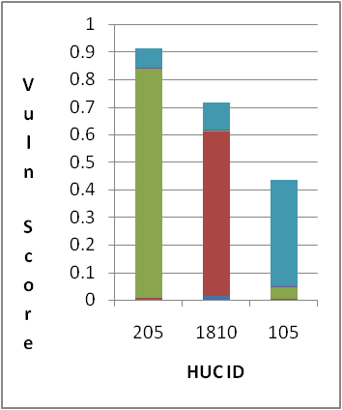
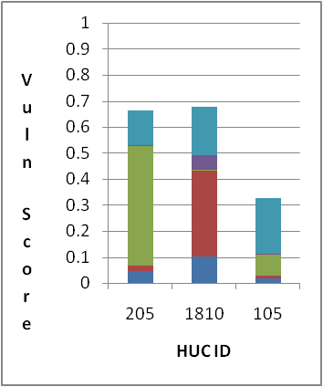
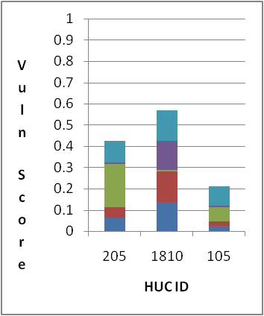

Pessimistic
Contribution of Constituent Indicators
Optimistic
Pessimistic Outlook
ORness = .95 High attribute values will contribute the most
Tradeoff = .23 Lower values contribute very little to the score
Intermediate
ORness = .75 More lower-ranked variables contribute to the composite score
Tradeoff = .65 Lower values contribute more to the composite score
Optimistic Outlook
ORness = .50 Weights are equally spread across variables (Average)
Tradeoff = 1 Low values contribute equally with high values

Slide 53
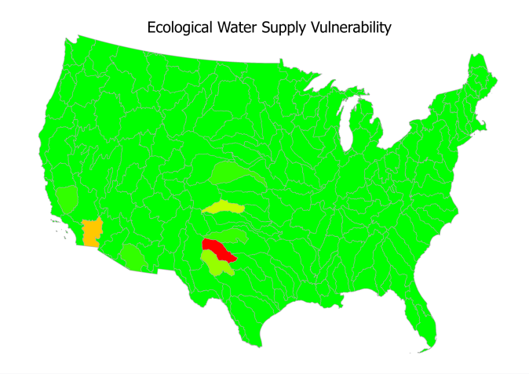
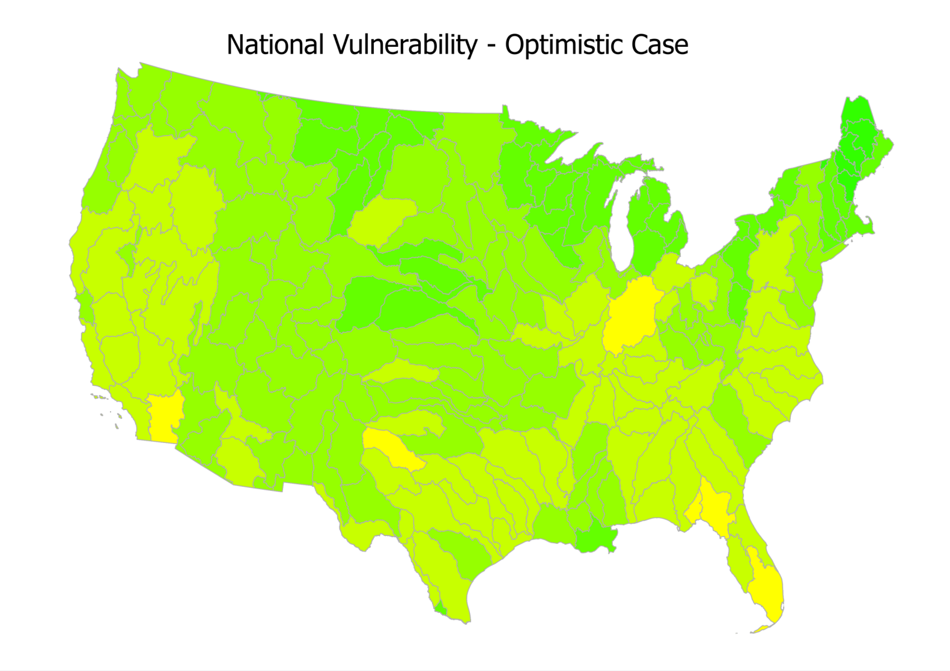

Slide 54
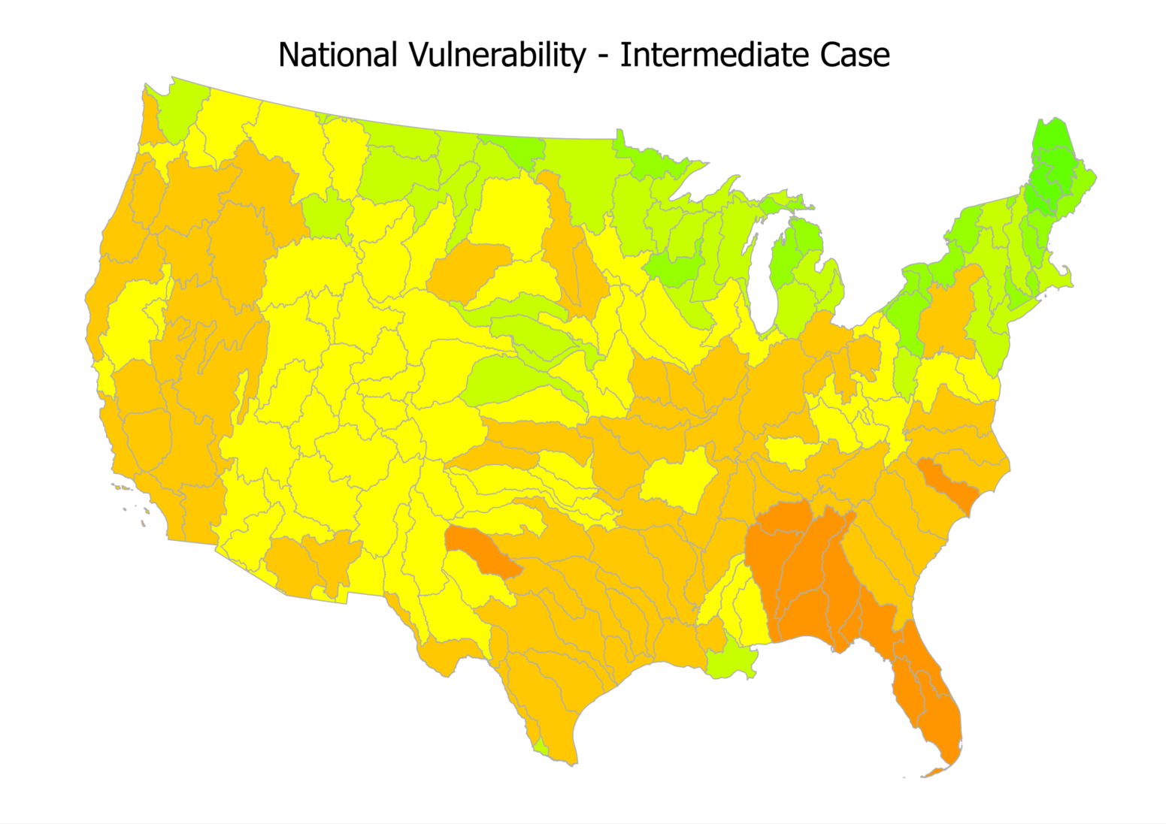

Slide 55
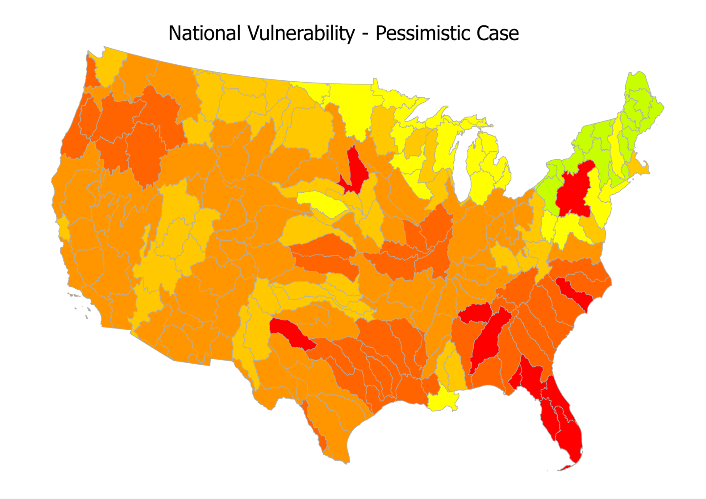

Slide 56



Pessimistic
Optimistic
Pessimistic Outlook
ORness = .95 Much more weight is given to high attribute values
Tradeoff = .23 Low Values are less able to average out high values
Mean Score = .71 Higher ORness and lower tradeoff will lead to higher scores.
Intermediate Case
“Or”ness = .75 More weight is given to high attribute values
Tradeoff = .65 Low Values are somewhat able to average out high values
Mean Score = .56 Decreasing ORness and increasing tradeoff will lead to decreasing scores.
Optimistic Outlook
“Or”ness = .50 Equally weights all variables (Takes an average).
Tradeoff = 1 Low Values are able to average out high values
Mean Score = .36 Smaller ORness and high tradeoff will lead to lower scores.

Slide 57
Today’s Goals
What is data aggregation? Why use it?
What is an example of data aggregation?
What else should I know?

Slide 58
Many Different Types of Aggregation
I suggest you use OWA, as you can control the degree of tradeoff. Alternatives other than WLC include:
Data Envelopment Analysis
Pareto Rank Order
Weighted Ordered Weighted Average

Slide 59
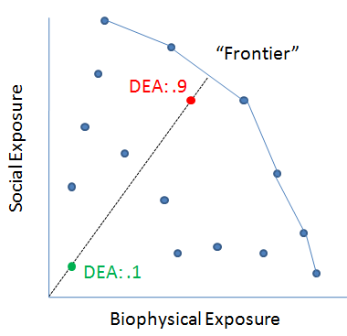
Data Envelopment Analysis
First, establish the frontier of options.
Second, from the origin, determine how far a given point lays on a straight line from the origin to the frontier.
This has the characteristic of placing a great deal of weight on the highest scoring indicator (similar to an OWA where Orness = 1).
If a new point is added which moves the frontier, the analysis has to be re-run.

Slide 60
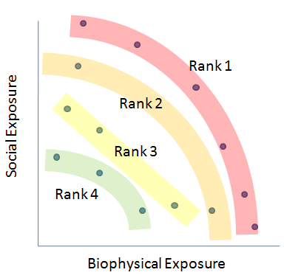
Pareto Rank Order
First, establish what units of analysis fall on the frontier. Label these as the highest rank of vulnerability.
Remove them from the analysis, and identify the next frontier, and rank them as the second highest. Repeat this until no further observations exist.

Slide 61
Comparison to other aggregation techniques
All the aggregation methods have their strengths and drawbacks. OWA has a variety of advantages similar to some of the other techniques reviewed. These drawbacks may be addressed in the techniques compared below but may require more adjustment than using OWA.
 | Weighted Linear Combination | Frontier Methods | Clustering | OWA
Tradeoff | High values can be averaged out by low values (High tradeoff) | Too many indicators can lead to all attributes being rated as highly vulnerable. | N/A, Numerical Scores are not assigned | Tradeoff can be selected
Weighting | Requires Subjective Weighting | Weighting makes no difference in results | Weighting makes no difference in results | Subjective weighting can be implemented, but is optional
Data Scaling | Sensitive to Scaling Techniques Adding additional areas of analysis will not change all results | Not Sensitive to Scaling Techniques Adding additional areas of analysis can change all results | Not Sensitive to Scaling Techniques Adding additional areas of analysis can change all results | Sensitive to Scaling Techniques Adding additional areas of analysis will not change all results
Interpretation | Interpretation of results not subjective | Interpretation of results not subjective | Requires a subjective interpretation of what clustered data represent | Interpretation of results not subjective

Slide 62
Important Caveats
Methods are almost always RELATIVE: You can only say “According to the method, HUC 1 is more vulnerable than HUC 2”.
Absolute statements can almost never be made: You can NOT say “HUC 1 is 10 times more vulnerable than HUC 2”.
These methods can be very sensitive to assumptions: Importance weights, standardization methods, normality of data.

Slide 63
Appendix

Slide 64
Why OWA?
Flexible: The technique is flexible allowing for a range of aggregation solutions ranging from optimistic outlooks (full trade-off among constituent indicators, perhaps overlooking some HUCs that are vulnerable) to pessimistic outlooks (no trade-off among constituent indicators, likely not omitting any HUC that may be vulnerable) through the choice of order weights. The solution with all order weights equal (optimistic outlook, full trade-off is allowed) results in the Equal-Weights Weighted Linear Combination (WLC) widely used in the extant literature on Vulnerability Indicators.
Consistent/Reproducible: a consistent and reproducible method for obtaining the order weights can be selected. There are a number of methods in the literature, we have chosen to use the maximum entropy method which tries to equalize weights for the constituent indicators for any chosen decision strategy (uses as much of the information in all indicators as possible).
Notes:
Add WLC is a subset of this technique
And adding importance weights

Slide 65
Why OWA?
“Importance” Weights: If some constituent indicators are deemed more important to the vulnerability assessment, this preference can be incorporated by using the importance weights (pre-conditioning) before using the order weights, and renormalizing.
Use with other techniques: The large number of constituent indicators being developed for each Corps business line may prescribe the use of a data reduction technique such as principal Component Analysis (PCA). The OWA aggregation method can be used to combine the PCA indicators.
Notes:
Add WLC is a subset of this technique
And adding importance weights
Can be implemented in the WIDT: Using pre-developed entropy weights for a range of Decision Strategies (Trade-off, ORness values) and numbers of constituent indicators, and incorporating a renormalization technique, the OWA can be implemented in the WIDT within the time-frame of the current project.

Slide 66
Obtaining The Maximum Entropy Rank Weights
While each value of ORness has multiple potential sets of weights, the weights chosen in these examples are based on the principal of maximum dispersion. For a given level of ORness (Trade-off, Decision Strategy), a unique set of weights that is the most ‘equal’ across the constituent indicators is obtained through the solution of a non-linear constrained optimization problem. Spreading the weights as much as possible given the decision strategy uses as much information in the constituent indicators for that level of ORness.

Slide 67
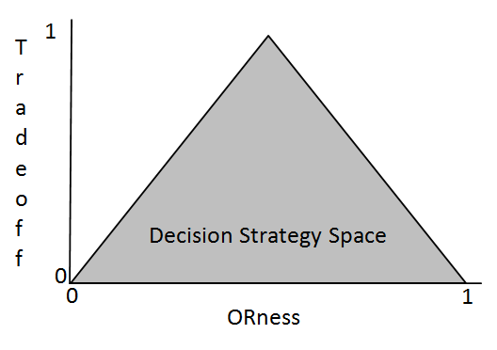
Obtaining The Maximum Entropy Rank Weights
The solution to the constrained optimization finds the order weights that guarantees the weights chosen will have the highest level of Trade-off (the Y axis) for that level of ORness (points on the outer edge of the Decision Strategy Triangle). We are only using the right half of the triangle, where the ORness level goes from 0.5 (full trade-off), to 1.0 (highest constituent indicator given all the weight, trade-off).

Slide 68

National Map HUC 4: Optimistic Decision Strategy

Slide 69

National Map HUC 4: Intermediate Decision Strategy

Slide 70

National Map HUC 4: Pessimistic Decision Strategy

Slide 71


Slide 72


Slide 73


Slide 74


Slide 75


